Slide 1
Rangama
A new Anagram game

Slide 2
Game Development Objectives
Utilize latest web development technologies
Collaborate as a team
Have fun!

Slide 3
Major Project Requirements
Use a Node and Express Web Server
Be supported by a MySQL database and an ORM interface
Use GET/POST connection routes
Deploy the app using Heroku
Apply a new library, package or technology
Demonstrate good quality coding practices including MVC folder structures

Slide 4
Game Purpose
The purpose of the game is primarily for entertainment. However an educational or training aspect is viable if the application is extended to include customized requirements.

Slide 5
Development Hurdles & Decisions
Decision on a application
Negotiation regarding extent of project scope

Slide 6
Coding Plan-Front end
HTML/CSS
Anagram Node Package-retrieve list of anagrams
Match words entered to the anagram list
Swap letters with hotkeys (?)
Generate new words
Keep track of score
Submit score

Slide 7
Coding Plan - continued
Back-end
Database
Request pre-existing word & anagrams from MySQL
On the fly response sending with total word score
Store player score to db
Server correct pages with Express
Store pre-existing anagrams into the database

Slide 8
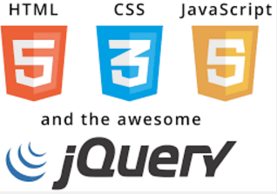
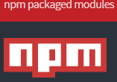
Technologies used:

